Slide 1
Shared Objects & Serialization
Distributed Computer Systems
CT024-3-3-DCOMS and Version VC1

Slide 2
Topic & Structure of The Lesson
Shared Objects
What is serialization?
Distributed objects

Slide 3
Learning Outcomes
At the end of this topic, You should be able to
Understand about the shared objects
Describe about the serialization
Implementing serialization in RMI

Slide 4
Key Terms You Must Be Able To Use
If you have mastered this topic, you should be able to use the following terms correctly in your assignments and exams:
Shared Objects
Distributed Objects
EJB
Serialization

Slide 5
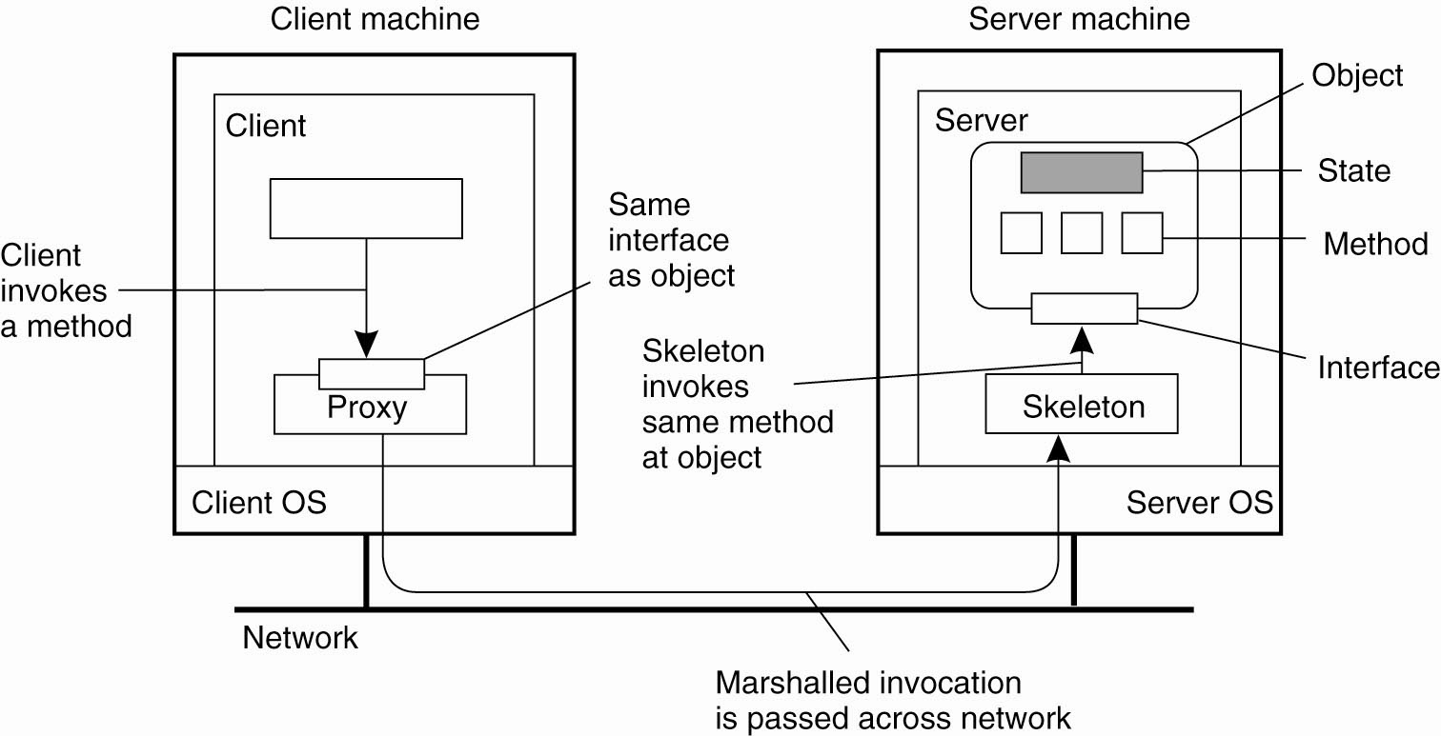
Distributed Objects
Common organization of a remote object with client-side proxy

Slide 6
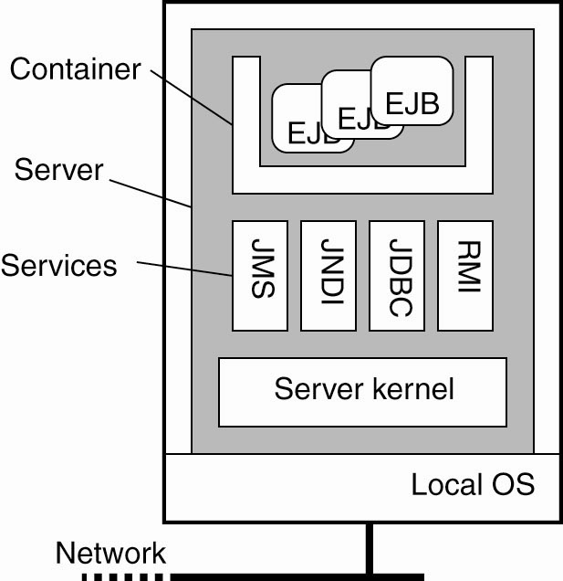
Example: Enterprise Java Beans(EJB)
General architecture of an EJB server

Slide 7
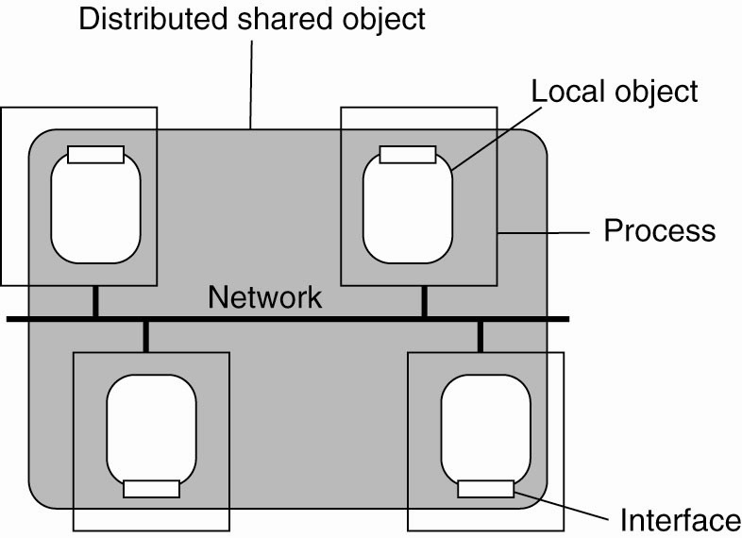
Globe Distributed Shared Objects
The organization of a Globe distributed shared object

Slide 8
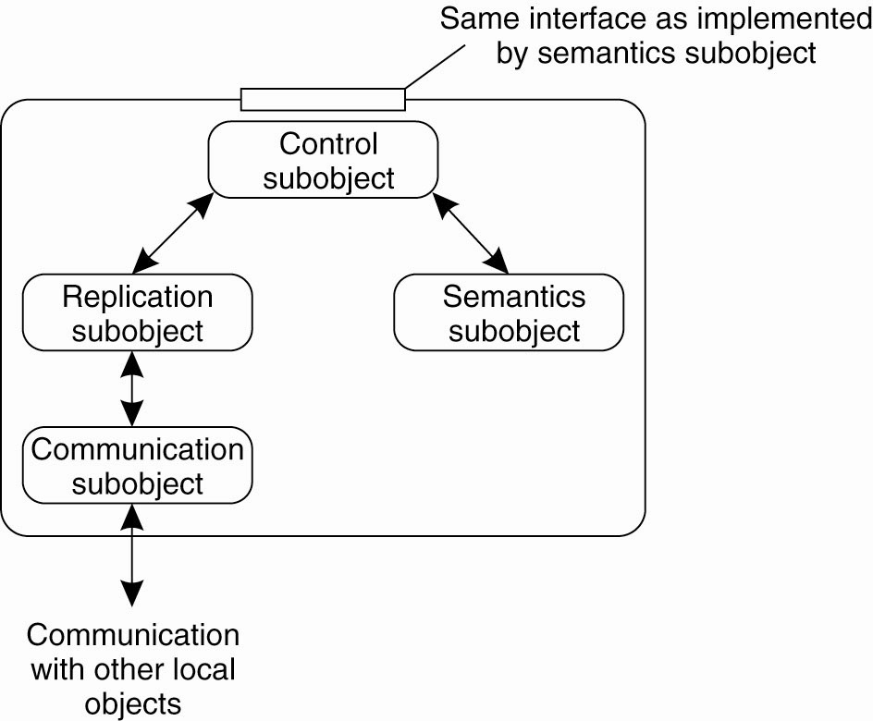
Globe Distributed Shared Objects
The general organization of a local object for distributed shared objects in Globe

Slide 9
Question
How to pass information form client to server and vise versa?
How to pass information between client and server?
Notes:
When you call a remote method with RMI, the method arguments are packaged (marshaled) into a byte stream and shipped over the network to the remote JVM, where they are unpacked (un-marshaled) and passed to the remote method.
When the RMI code calls your remote object, in what thread does that call happen?
You don't know, but it's definitely not in a thread you created your object gets called in a thread managed by RMI. How many threads does RMI create? Could the same remote method on the same remote object be called simultaneously in multiple RMI threads?

Slide 10
I/O Streams
An I/O Stream represents an input source or an output destination. A stream can represent many different kinds of sources and destinations, including disk files, devices, other programs, and memory arrays.
Streams support many different kinds of data, including simple bytes, primitive data types, localized characters, and objects. Some streams simply pass on data; others manipulate and transform the data in useful ways.
No matter how they work internally, all streams present the same simple model to programs that use them: A stream is a sequence of data. A program uses an input stream to read data from a source, one item at a time:

Slide 11
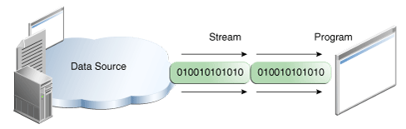
Reading information into a program

Slide 12
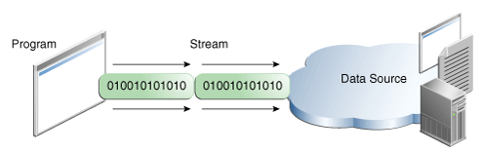
A program uses an output stream to write data to a destination, one item at time, Writing information from a program.
Flow -1

Slide 13
What is Serialization?
Usually Java allows creation of objects in the memory using JVM life time
Do we really need to make some object which can last longer?
Serialization allows you to create your objects and reuse them later

Slide 14
What is Serialization? (Continue)
It will save an object's state into a sequence of bytes and when it is required, it will rebuild those bytes into a live object.
It will save:
Only the class name
The object’s data (it will assign a serial number to objects)
If that data is an object, it is also saved
It will not save:
Methods
Static information

Slide 15
Advantage and Disadvantage
Pros
Facilitate the transportation of an object through a network
Create a clone of an object
Cons
Resource overhead (both the CPU and the IO devices)
Issues of transmitting the data over the network
Serialization is quite slow
Serialization is insecure

Slide 16
How to use Serialization?
Java provides an object for serialization, it is an interface called java.io.Serializable
public class MyClass implements java.io.Serializable {
Notes:
•If Java classes implement this interface, then objects instantiated from these classes can be translated into a byte stream that is sent across a network
•This byte stream is sufficient for the reconstruction of the serialized object when it is read by the receiving program

Slide 17
Java Streams
Java uses input/output “streams” as follow
Byte Streams: such as FileInputStream, FileOutputStream
Character Streams: similar to FileReader, FileWriter
Buffered Streams: like BufferedReader, BufferedWriter
Data Streams: binary I/O of primitive data type values
like boolean, char, byte, short, int, long, float, and double) as w ell as String values
Object Streams: for example ObjectInputStream, ObjectOutputStream
Java provides means to read / write
Provided methods: readObject(), writeObject() etc.
Usage:
Scanning and Formatting
I/O from the Command Line
Sending / receiving values and objects via a network

Slide 18
Serialization rules
The object to be persisted must implement the Serializable interface or inherit that implementation from its object hierarchy
The object to be persisted must mark all Nonserializable fields transient

Slide 19
Serialization provides
A method of persisting the objects
write an object properties to a file on disk, or save to a database.
A method of RPC.
A method for distributing objects.
A method for detecting changes.

Slide 20
Uses of serialization
As a persistence mechanism
If the stream being used is FileOutputStream, then the data will automatically be written to a file.
As a copy mechanism
If the stream being used is ByteArrayOutputStream, then the data will be written to a byte array in memory. This byte array can then be used to create duplicates of the original objects.
As a communication mechanism
If the stream being used comes from a socket, then the data will automatically be sent over the wire to the receiving socket, at which point another program will decide what to do.

Slide 21
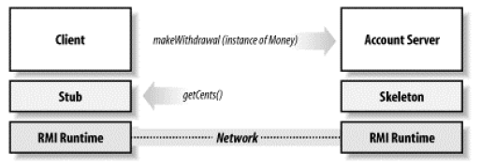
Need of Serialization?

Slide 22
Deserialization
Serialization is a mechanism of converting the state of an object into a byte stream. Deserialization is the reverse process where the byte stream is used to recreate the actual Java object in memory. This mechanism is used to persist the object.

Slide 23
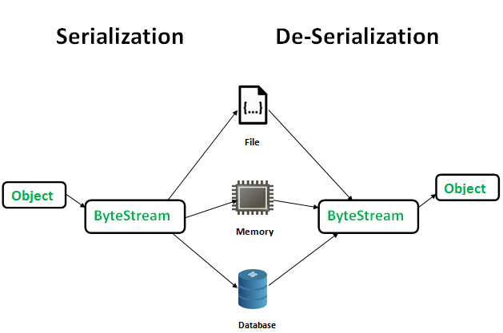

Slide 24
The byte stream created is platform independent. So, the object serialized on one platform can be deserialized on a different platform.
To make a Java object serializable we implement the java.io.Serializable interface. The ObjectOutputStream class contains writeObject() method for serializing an Object.
public final void writeObject(Object obj) throws IOException
The ObjectInputStream class contains readObject() method for deserializing an object.
public final Object readObject() throws IOException, ClassNotFoundException

Slide 25
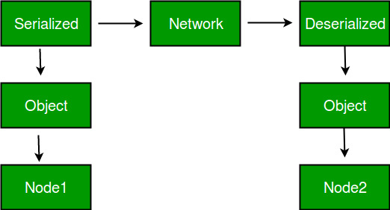
Advantages of Serialization 1. To save/persist state of an object. 2. To travel an object across a network.

Slide 26
Only the objects of those classes can be serialized which are implementing java.io.Serializable interface. Serializable is a marker interface (has no data member and method). It is used to “mark” java classes so that objects of these classes may get certain capability. Other examples of marker interfaces are:- Cloneable and Remote.
Points to remember 1. If a parent class has implemented Serializable interface then child class doesn’t need to implement it but vice-versa is not true. 2. Only non-static data members are saved via Serialization process. 3. Static data members and transient data members are not saved via Serialization process.So, if you don’t want to save value of a non-static data member then make it transient. 4. Constructor of object is never called when an object is deserialized. 5. Associated objects must be implementing Serializable interface.

Slide 27
class A implements Serializable
{
// B also implements Serializable // interface
B ob=new B();
}
SerialVersionUID
The Serialization runtime associates a version number with each Serializable class called a SerialVersionUID, which is used during Deserialization to verify that sender and reciever of a serialized object have loaded classes for that object which are compatible with respect to serialization. If the reciever has loaded a class for the object that has different UID than that of corresponding sender’s class, the Deserialization will result in an InvalidClassException. A Serializable class can declare its own UID explicitly by declaring a field name.

Slide 28
It must be static, final and of type long. i.e- ANY-ACCESS-MODIFIER static final long serialVersionUID=42L;
If a serializable class doesn’t explicitly declare a serialVersionUID, then the serialization runtime will calculate a default one for that class based on various aspects of class, as described in Java Object Serialization Specification. However it is strongly recommended that all serializable classes explicitly declare serialVersionUID value, since its computation is highly sensitive to class details that may vary depending on compiler implementations, any change in class or using different id may affect the serialized data.
It is also recommended to use private modifier for UID since it is not useful as inherited member.

Slide 29
serialver The serialver is a tool that comes with JDK. It is used to get serialVersionUID number for Java classes. You can run the following command to get serialVersionUID
serialver [-classpath classpath] [-show] [classname…]

Slide 31
Summary
Java allows creation of objects in the memory using JVM life time
Serialization allows you to create your objects and reuse them later
Serialization saves only the class name

Slide 32
Question and answer session
Q & A

Slide 33
What we will cover next
Security

